Slide 1

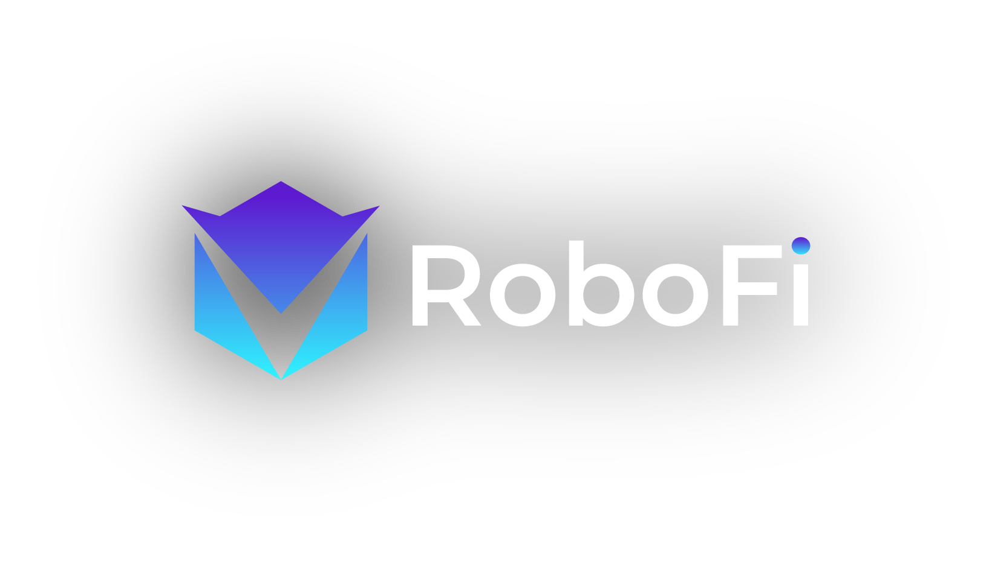
EXCLUSIVE TOKEN SALES PRESENTATION
DAO Crypto Trading Bots Marketplace That Offers IBO(Initial Bot Offering)

Slide 2


INTRODUCTION

Slide 3
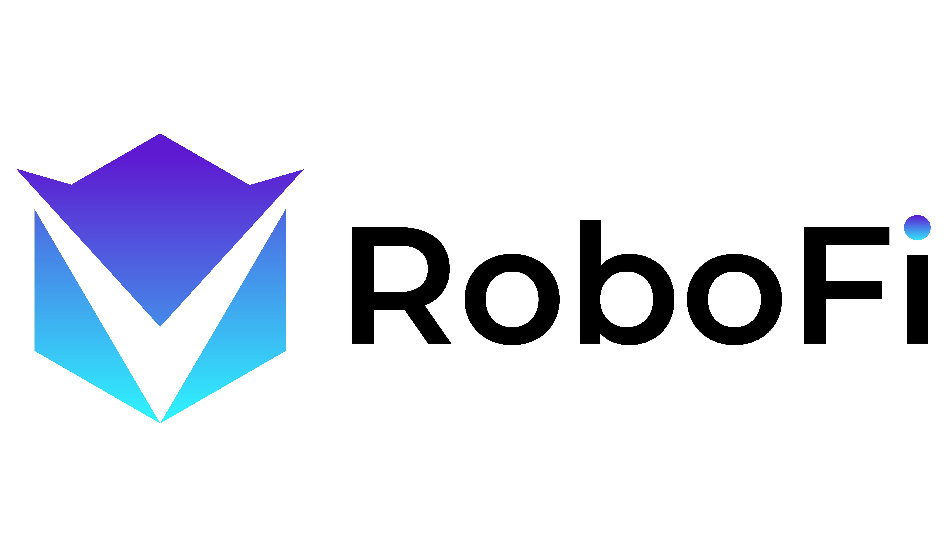
WHAT IS ROBOFI AND VICS TOKEN?
RoboFi is the world 1st Defi platform that offers IBO(Initial Bot Offering) on DAO(Decentralized Autonomous Organization) concept bots. All transactions in the RoboFi is recorded thru smart contracts and is fueled by VICS Tokens (BEP20).
RoboFi aims to fill those gaps and serve as a platform for bot creators to connect with the community through IBO(Initial Bot Offering). RoboFi want to bring consensus between bot creators and users in an ecosystem that encourages mutual financial growth and innovation.
Our Goal is to bringing DAO Trading Bots to Everyone.

Slide 4

PROBLEMS & SOLUTION

Slide 5
PROBLEMS
USERS
BOT CREATORS
“The market is extremely volatile. It’s hard to deal without proper knowledge and trading skills.”
“Market opens for 24/7/365. I don’t have the time to trade but would like a passive income source.”
“Many trading bots are available but are either hard to use or are not profitable. “
“I found a bot creator who claims that his bot is profitable. But it's hard to trust. “
“There are too many scams. I don't feel secure in entrusting my funds.”
“I develop profitable trading bots. However, it is not easy to share with others due to privacy and disproportionate payouts.”
“My trading bots are great, but I don’t know where I can get the funds to trade.”
“A group of individuals are interested in using my bots, but arranging the payout is a big headache.”
“I guarantee that my trading bots can make profit, but users do not trust me.”

Slide 6

SOLUTION: ROBOFI PLATFORM
Defi platform to offer earning opportunities to users by accessing various DAO crypto trading bot's marketplace.
Offering IBO (Initial Bot Offering) to bot creators who want to raise capital and to users who want to be a bot governance shareholder.
Accessible and transparent platform that connects bot creators and individuals.
Institution-grade crypto trading bots.
Leverage blockchain technology to audit all transactions through smart contract.
Exchange verified P&L.
Zero knowledge is need to use the platform.
User-friendly interface.
The RoboFi ecosystem brings the value of professional portfolio management to everyone in an automated, transparent, and verifiable way.

Slide 7

ROBOFI ECOSYSTEM

Slide 8
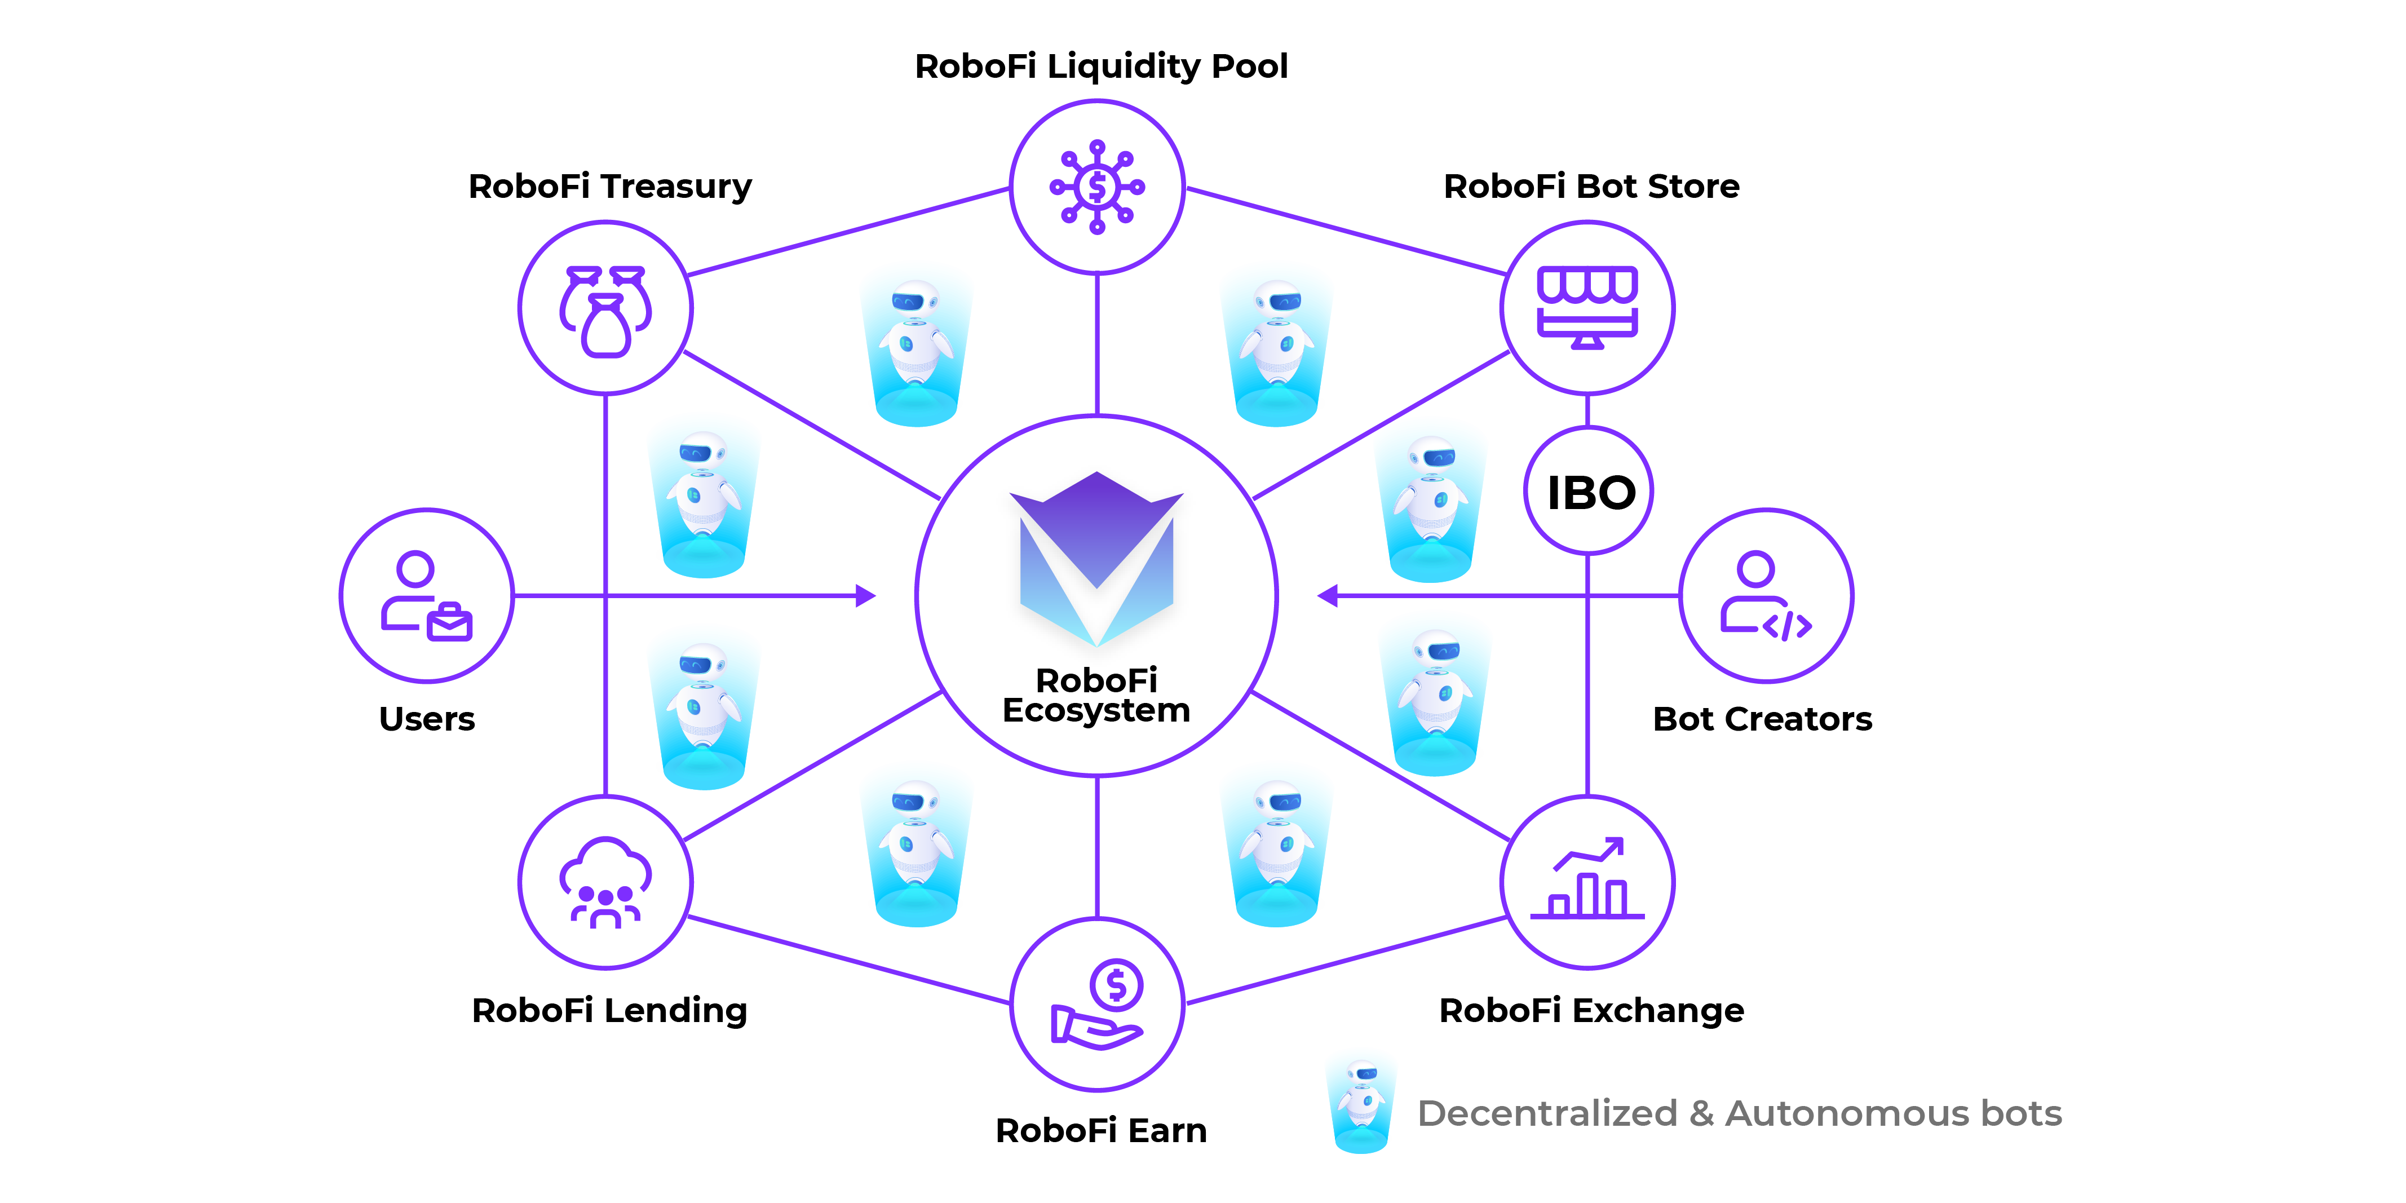

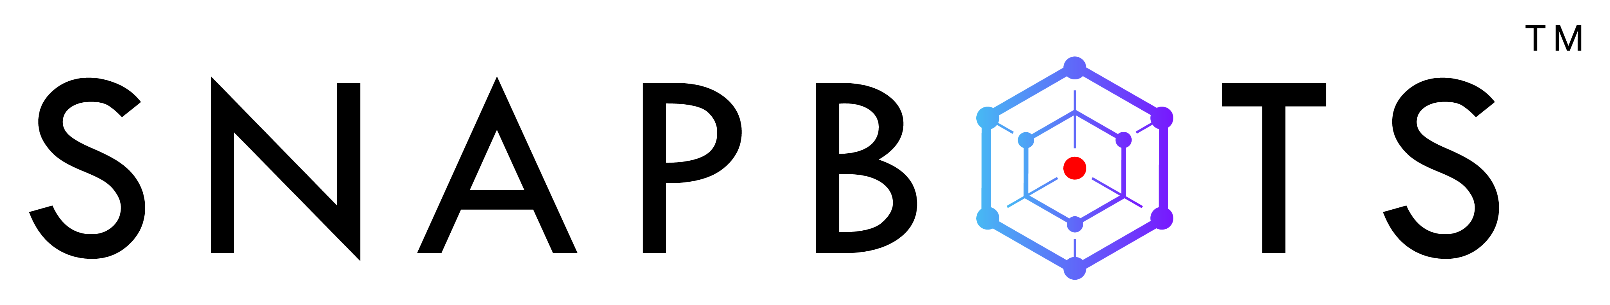
ROBOFI ECOSYSTEM
RoboFi Wallet
SnapBots Users

Slide 9

WHAT IS IBO & DAO BOTS?
IBO(Initial Bot Offering): An Initial Bot Offering is a type of the first sale of DAO Bots to the public conducted for the purpose of raising funds to trade.
All users can be participated in IBO.
Users who participated in IBO will earn governance shares of bots and fund will be traded for trading.
Activities are all transparent and verifiable in blockchains.
DAO(Decentralized Autonomous Organization): An organization represented by rules encoded in computer program, controlled by the organization members and not influenced by a central government.
Decentralized Autonomous Bots that are controlled, configured via the DAO principles, i.e., voting.
Activities are all transparent and verifiable in blockchains.
Trading performance is trackable 24/7 in DEX, CEX but not limited to Equity Stock markets (SET, IDX, Nasdaq) and Forex.

Slide 10
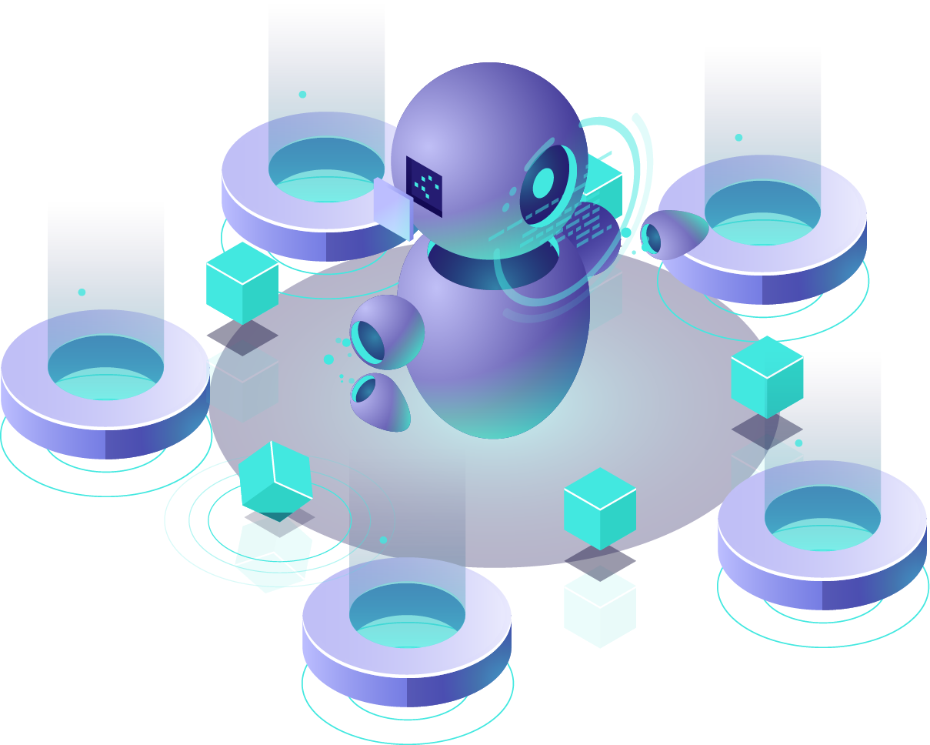
PARTICIPANT’S BENEFITS
1
Traders
For End-users:
To store cryptocurrency safely.
To participate in IBO and hold bot shares.
To borrow cryptocurrency.
To earn passive income.
For Bot Creators:
To raise the fund.
To earn more profit on bots.
For RoboFi Operators:
To provide transparent environment.
To ensure the security, privacy for the system.
Operators
Bots
Creators
2
Stake
users
Governance
users
3

Slide 11
WHY ROBOFI ECOSYSTEM?
Blockchain is changing the world and with it the old business structures.
Fairness: Community-based decision makers instead of relying on one person.
Transparency: Transparent as every decision is recorded on a public ledger.
Efficiency: Once a standard set of rules are in place, most decisions can be automated.
Privacy: DAO is autonomous.
1
2
3
4

Slide 12

TOKEN DETAILS

Slide 13


TOKEN TYPES AND USAGES
VICS Token: To buy governance shares of bots. Default token for all bots to accept.
1
Staking: Users can stake in RoboFi earn and earn the passive income.
Payment: Buying the trading signals and other bots on the marketplace.
IBO Participation: Each bots will go through IBO and users can be the part of IBO.
Governance Shares Purchase: Those who failed to be in IBO but would like to be the governance of the bots, still can purchase governance share in internal exchanges using VICS.
Much More: In the future, many services will be available with VICS.
2
3
4
5

Slide 14
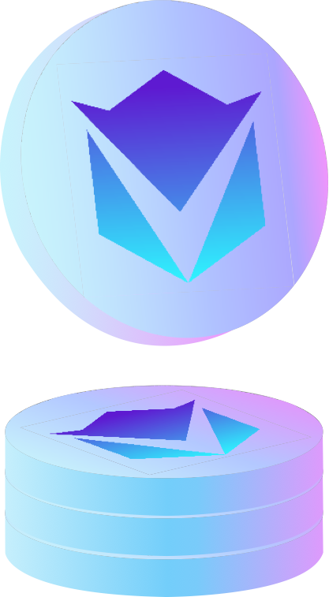
TOKEN DETAILS
Token Name: RoboFi Token
Ticker: VICS
Token Type : BEP20
1st/2nd Round Private Sales: 11.9 Million USD raised.
Total Supply: 600 Million VICS

Slide 15
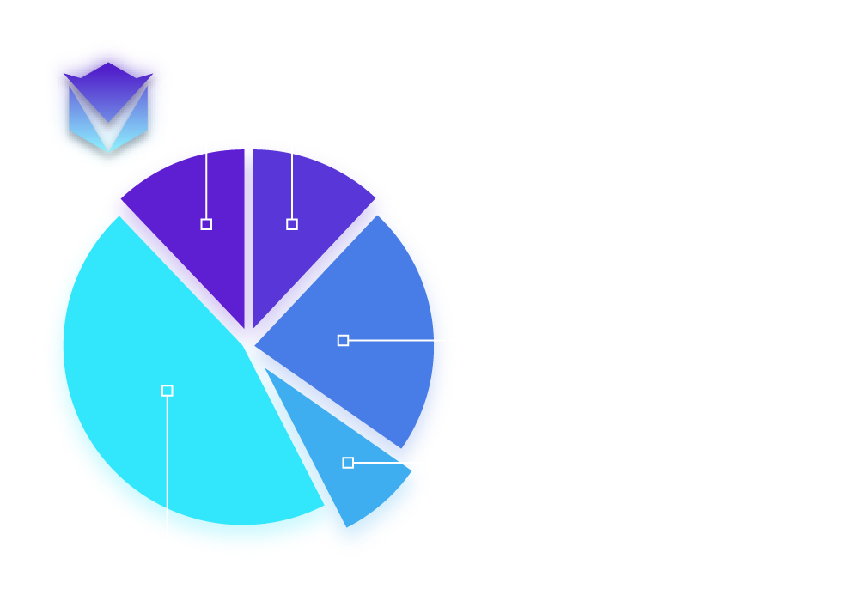
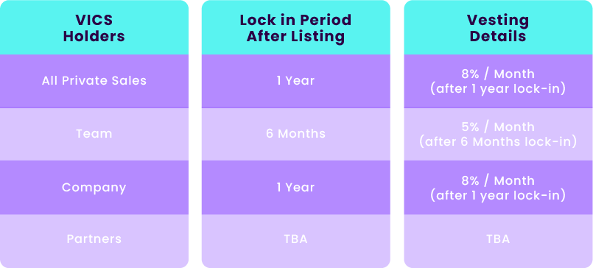
TOKEN ALLOCATION

Slide 16
PUBLICATION

Slide 17
PUBLICATION
BLOOMBERG
https://www.bloomberg.com/press-releases/2021-06-14/robofi-launches-its-power-ecosystem-fueled-by-vics-token
ASAHI
https://www.asahi.com/and/pressrelease/405637436/
YAHOO Finance Global
https://finance.yahoo.com/news/robofi-launches-power-ecosystem-fueled-135100527.html
BUSINESSINSIDER
https://markets.businessinsider.com/news/stocks/robofi-launches-its-power-ecosystem-fueled-by-vics-token-1030520099
BENZINGA
https://www.benzinga.com/pressreleases/21/06/g21549591/robofi-launches-its-power-ecosystem-fueled-by-vics-token
MARKETWATCH
https://www.marketwatch.com/press-release/robofi-launches-its-power-ecosystem-fueled-by-vics-token-2021-06-14

Slide 18
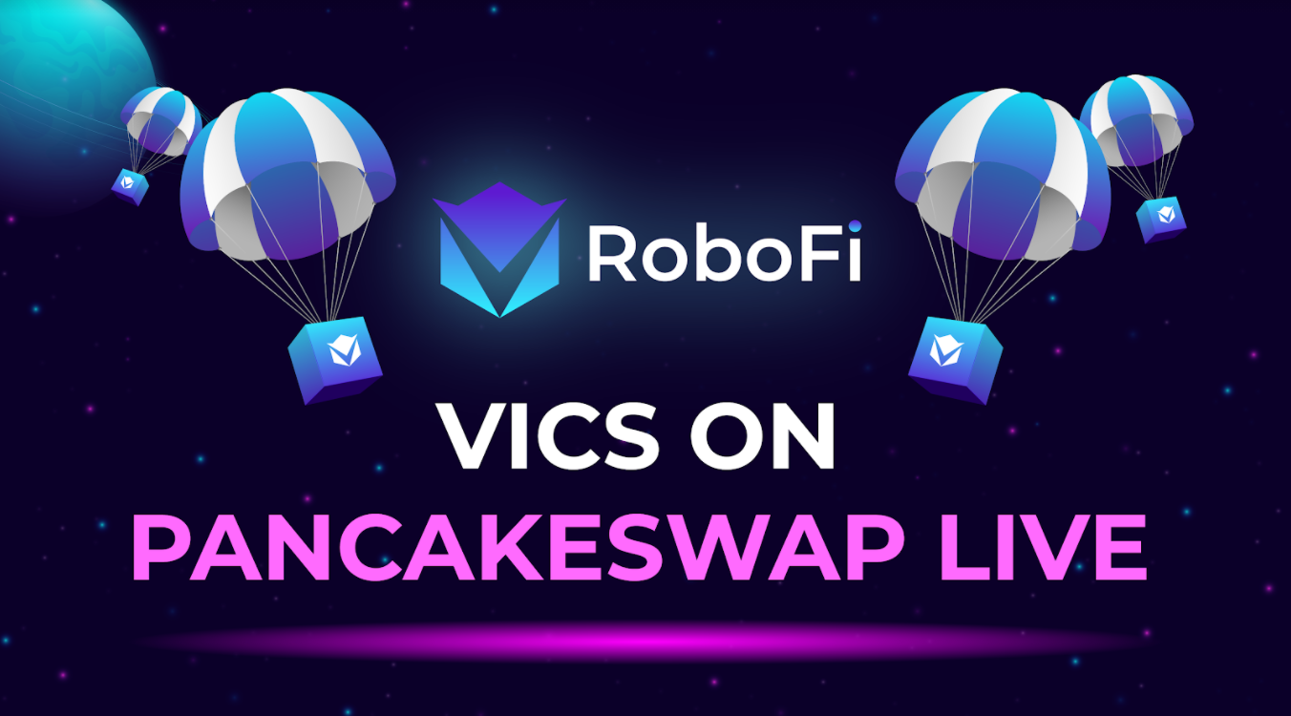
BUY ON PANCAKESWAP
GET IT TODAY!

Slide 19

CONTACT
More Information
Official Community
info@robofi.io
t.me/RoboFi_VICS
Visit Our Website
www.robofi.io

